Slide 1
“Codetry” (Code Poetry)
By: Shereece A.A. Victor

Slide 2
The Story Behind it
Code Poetry is a pleasant mixture programming and the aesthetics and smooth flow of poetry. It combines the challenge and enjoyment of both forms of craft. They are both art in my eyes.
My poem “Rainbows and Sunshine”, aims to brighten the day of anyone who reads the source code or uses the program it makes up.

Slide 3

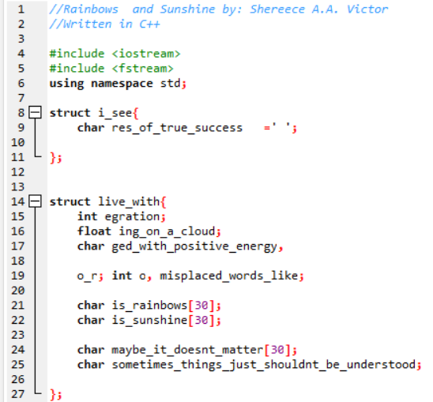
The program is written using carefully chosen variable names that are both functional and poetic when read.
The beauty at the Backend (part 1)
Of course, some elements of the programming language may seem weird to the average English reader.
Luckily, everyone doesn’t have to read the back end of applications.

Slide 4
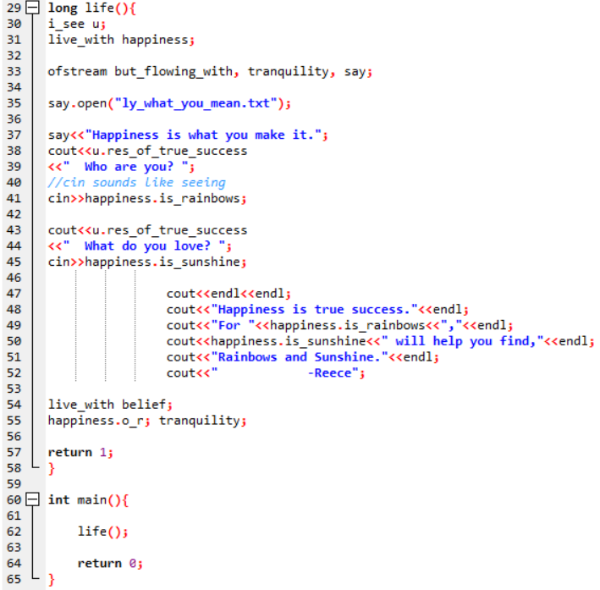
This part of the program, strays from the using variables and variable names that can be read as poem lines a bit to create a personalized poem as output for the user.
The beauty at the Backend (part 2)

Slide 5
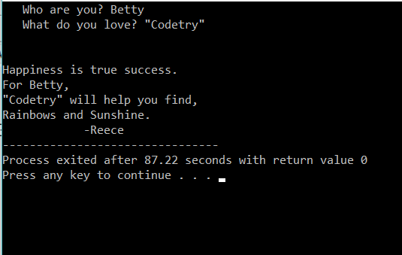
When someone runs the program first they enter their name, then something they love. They’re then presented with a poem written just for them about Happiness, Rainbows and Sunshine. Hopefully it puts a smile on their face.
What the User sees…

Slide 6
I like Code Poetry (“Codetry”) because:
Poems comfort people by making hard to communicate feelings and concepts sound relatable.
By creating programs we break problems down into simpler forms making them more understandable.
The combination of both is a beautiful merge of a new idea and a problem being solved. By the end of a code poem life should seem a tad bit easier.

